Slide 1
Algorithms & Data Structures II
Iteration, Recursion and Searching
Dr Jing Wang
jing.wang@shu.ac.uk
Cantor 9339

Slide 2
Iteration and Recursion

Slide 3
Iteration (Recap)
Loop
{
}
A Piece of Code

Slide 4
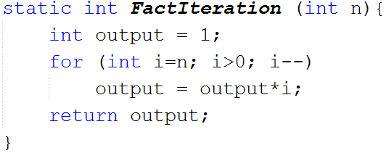


Slide 5
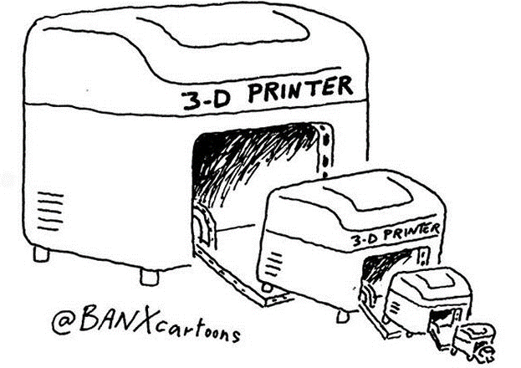
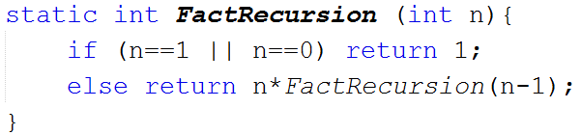
Recursion (Recap)
if (test for the base case)
return a fixed value
else
return some work containing recursive call(s)

Slide 6
4
4
4
4
4
3
3
3
3
3
FactRecursion(2)
2
2
2
FactRecursion(3)
2
2
FactRecursion(4)
1
1
1
1
1

Slide 7
4
4
4
24
4
4
6
3
3
3
3
3
2
FactRecursion(2)
2
2
2
FactRecursion(3)
2
2
1
FactRecursion(4)
1
1
1
1

Slide 8
Iteration vs Recursion
Iteration terminates when a condition is proven to be false
Each iteration does not require extra space unless "new" objects are created inside the loop.
An infinite iteration could loop forever since there is no extra memory being created.
Recursion terminates when a base case is reached
Each recursion call requires extra space on stack frame---------------------------------------
If we get infinite recursion, the program may run out of memory due to the stack overflow

Slide 9
Searching

Slide 10

Linear Search
It sequentially scans an array, comparing each array item with the search element
If search element is found in an array then the index of the element is returned
It can be applied to both sorted and unsorted arrays

Slide 11

19 is in the array and it is located at the 4th place
Where is 19?
Index
0
1
2
3
4
5
7
12
3
20
10
19
28
7
Array values
No
No
No
No
Yes!

Slide 12
Discussion
What is the best case scenario?
What is the worst case scenario?
12
3
20
10
19
28
7

Slide 13
Binary Search
Uses a divide and conquer strategy to determine if an item is in the collection
Exclude a group of elements at each step, focusing on the group it might be in
The collection needs to be ordered, e.g. ascending or descending order
Faster than linear search

Slide 14
Binary Search is used for sorted arrays
12
3
20
10
19
28
7
12
3
20
10
19
28
7
Some Sorting Algorithm

Slide 15
Strategy
Take the middle item in the subgroup and compare with our search item
Equal to the search item
Y
Find it!
N
Only check the subgroup items that are lower
Y
Bigger than search item
N
Only check the subgroup items that are higher
“subgroup” items at a specific step are those items from the full collection that have
thus far not been ruled out

Slide 16
We are looking for “19”…
19?
19 !
3
7
10
12
19
20
28
MID
28

Slide 17
Summary
Linear Search
Sequentially looks at each item in a collection until it is either found or the end of the collection has been reached
No special collection ordering is required
Inefficient and slow method for finding items, but can be useful
Binary Search
Divide and conquer to determine if an item is in the collection
The collection needs to be ordered (sorting may take sometime)
Faster than linear search

